Slide 1
Design Review: CGRA 3D PnR Using Nanoelectromechanical Relays
Michael Oduoza
October 30th, 2020

Slide 2
Section 1
Background and motivation

Slide 3
CGRA
Coarse Grained Reconfigurable Array (CGRA)
PE
MEM
PE
MEM
Tile
PE
MEM
PE
MEM
 | Processing Element
 | (PE) / Compute
 | Memory (MEM)
 | Switch box (SB)
 | Connection box (CB)
PE
MEM
PE
MEM
PE
MEM
PE
MEM
Notes:
CGRA is an array of PE tiles, whereby each PE tile consists of one Processing element, and some switch boxes and connection boxes. These PE tiles are all connected through routing tracks, which are the wires shown in blue. This is where most of the reconfigurability overhead comes from.

Slide 4
Single PE Tile

Slide 5
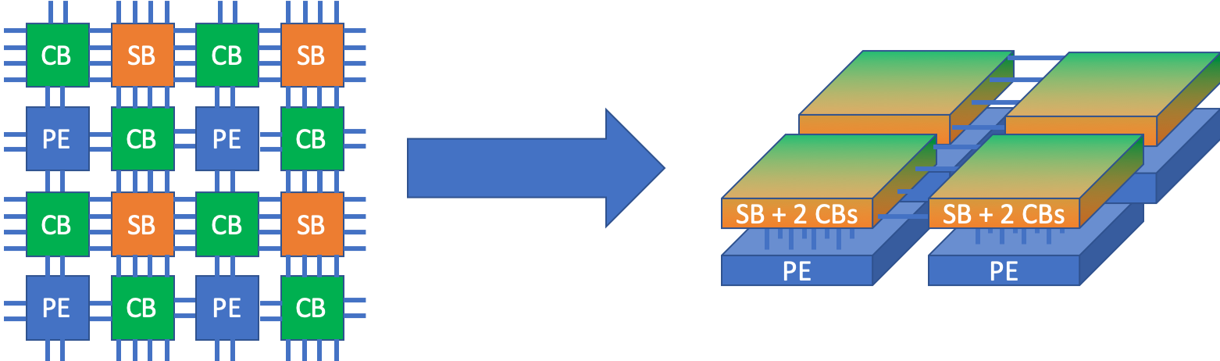
Concept – 3D PnR with NEM Relays

Slide 6
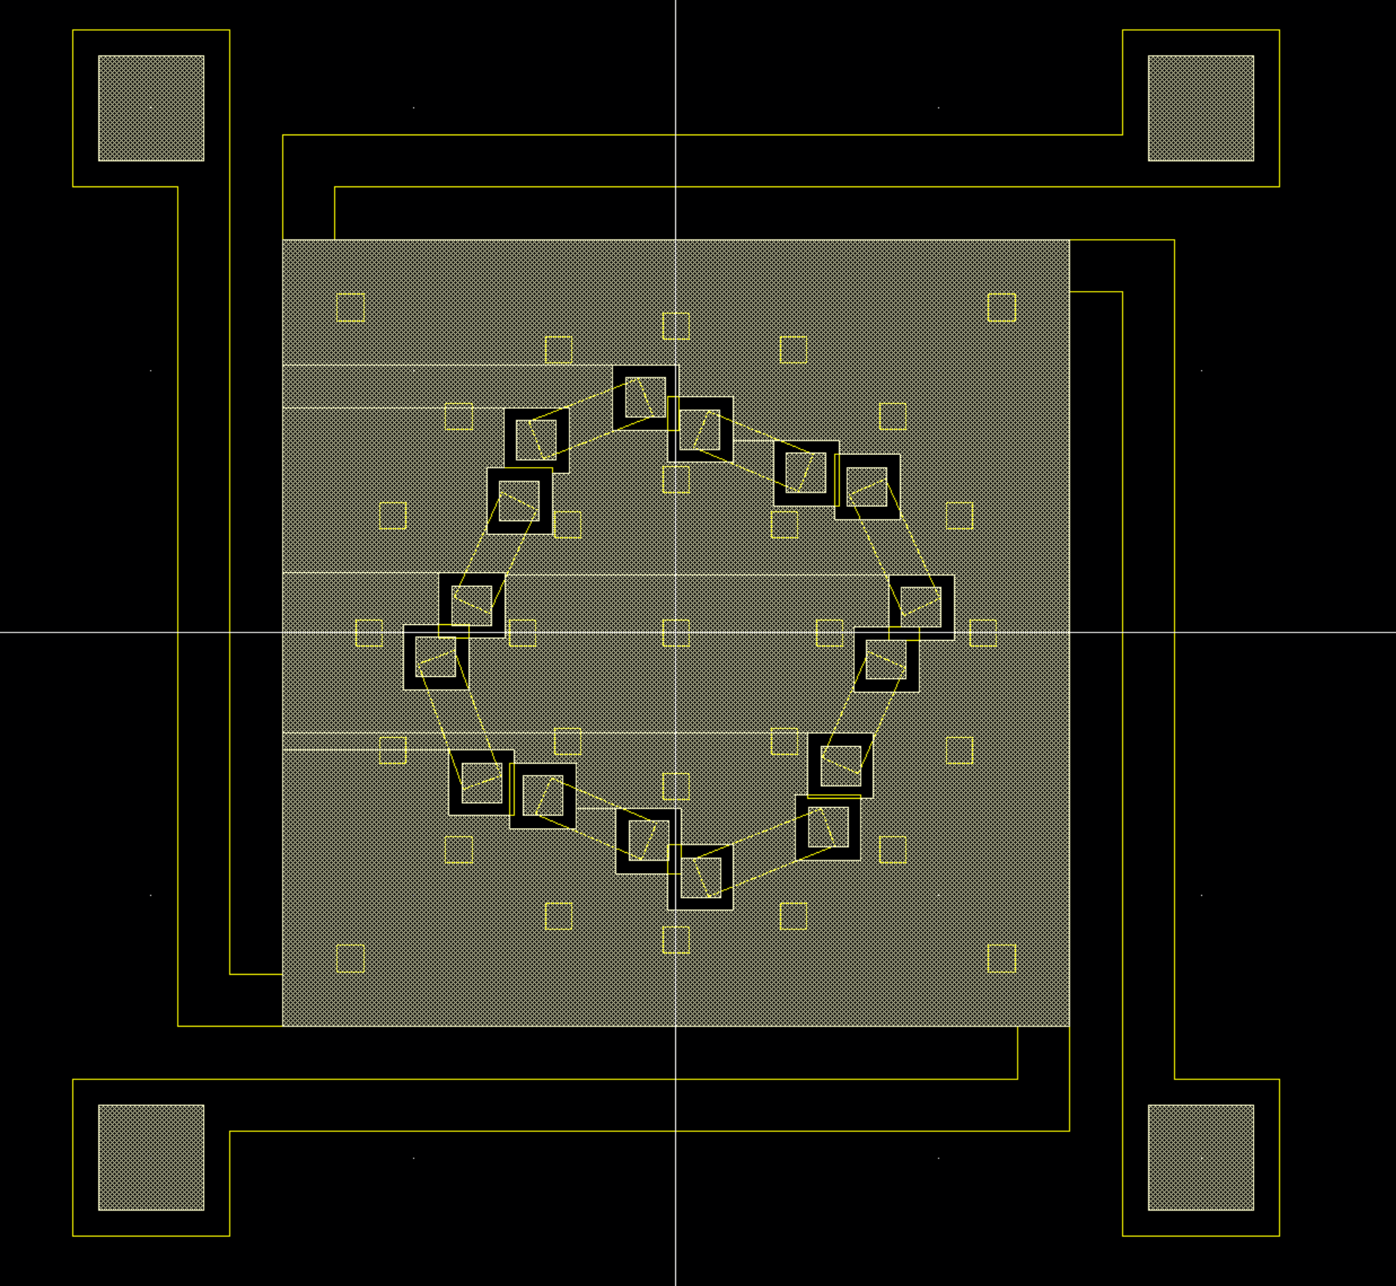

Multipole NEM Relay
Gate

Slide 7
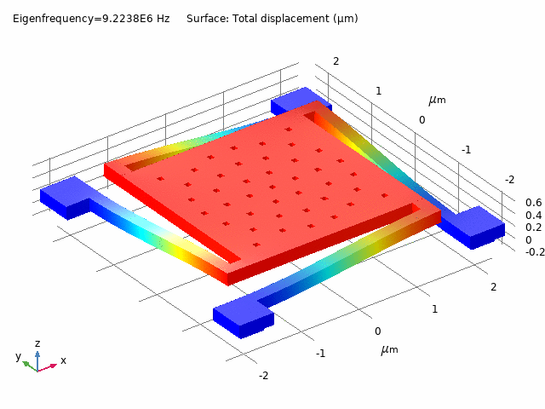
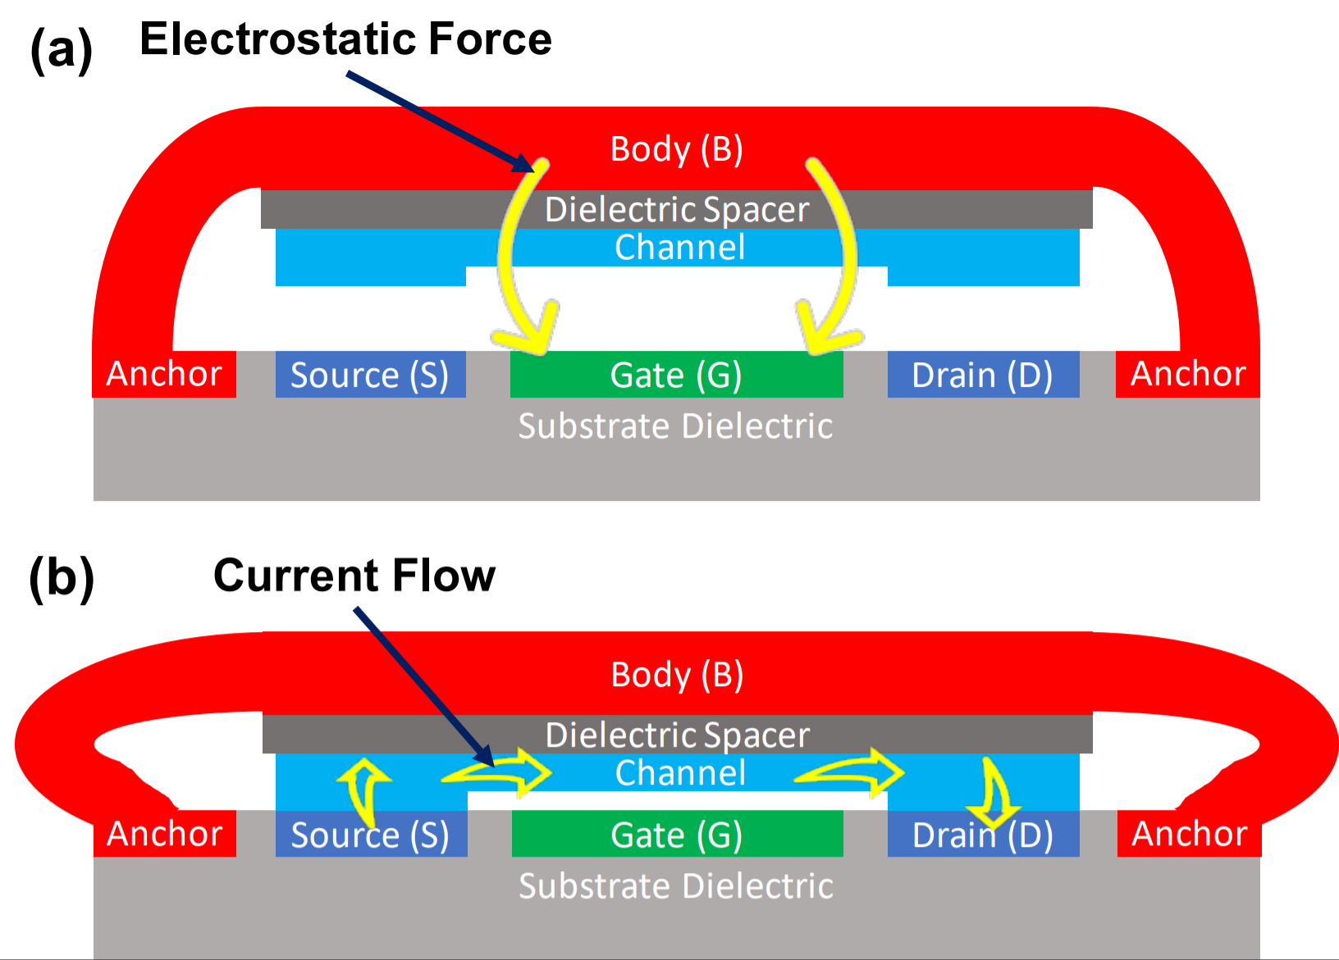
Multipole NEM Relay

Slide 8
3D PnR with NEM Relays
NEM Relay process flow compatible with standard CMOS BEOL flows
Allows for 3D integration

Slide 9
Section 2
NEM Relay-mux mapping

Slide 10
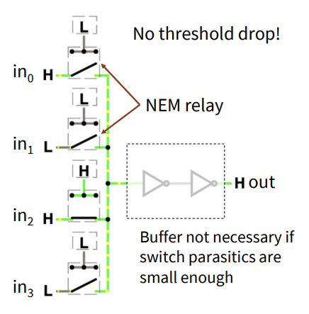
Mapping a Mux to Relay Switches
Similar to pass-gate logic

Slide 11
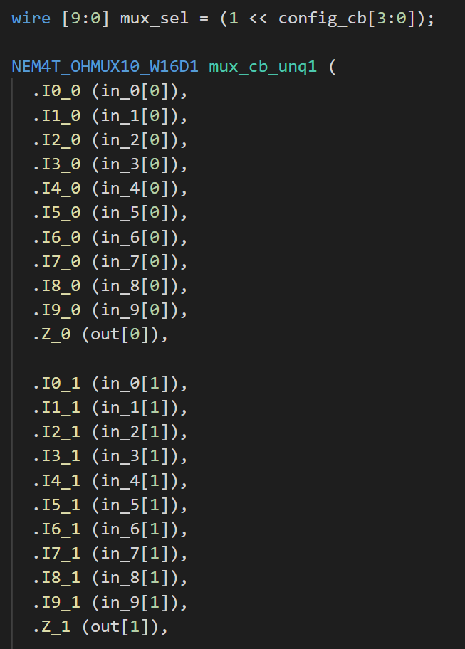
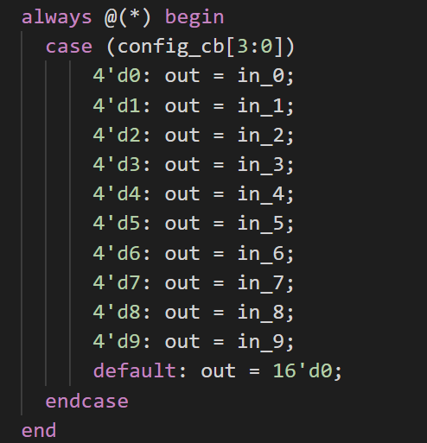
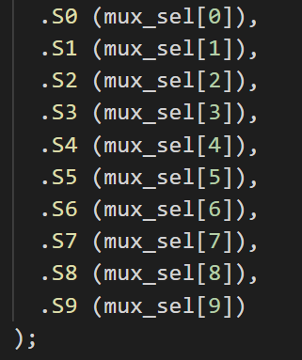
Connection Box - 16 bit

Slide 12
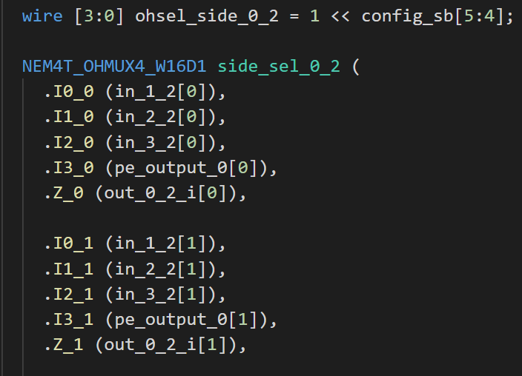
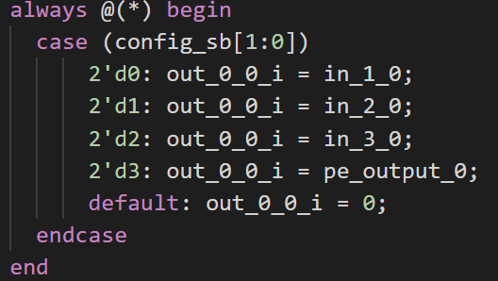
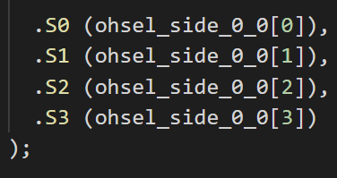
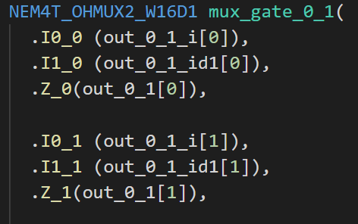
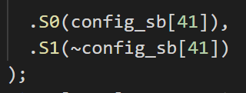
Switch Box - 16 bit

Slide 13
Table of Potential Mappings
Module | Type of Mux | # of Mux Occurrences in Module | # of Module Instantiations in PE Tile
16-bit CB | 10-to-1 | 1 | 2
1-bit CB | 14-to-1 | 1 | 4
16-bit SB | 2-to-1 | 20 | 1
16-bit SB | 4-to-1 | 20 | 1
1-bit SB | 2-to-1 | 20 | 1
1-bit SB | 4-to-1 | 20 | 1

Slide 14
Section 3
NEM Relay mux layouts

Slide 15
Design Hierarchy
VSNEM = -2.6V;
NEMBODY, NEMCHAN, etc.
M10 – Relay Gate, S/D
M9 – Horizontal Routing
M8 – VSNEM; Vertical Routing
M7 – VDD; VSS
M6 – VDD; VSS
M5-M1

Slide 16
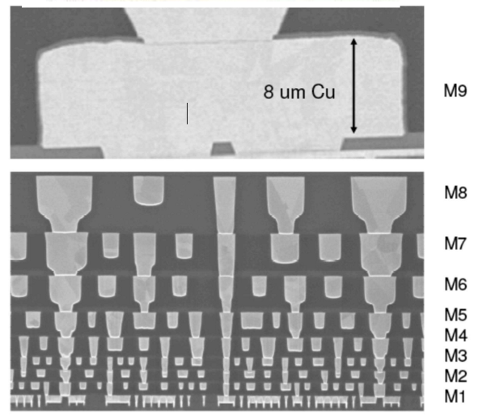
Metallization Hierarchy
M8, M9 will have same lithographic characteristics as M1, M2, etc.
To allow for dense routing in NEM mux layers (next slide)

Slide 17
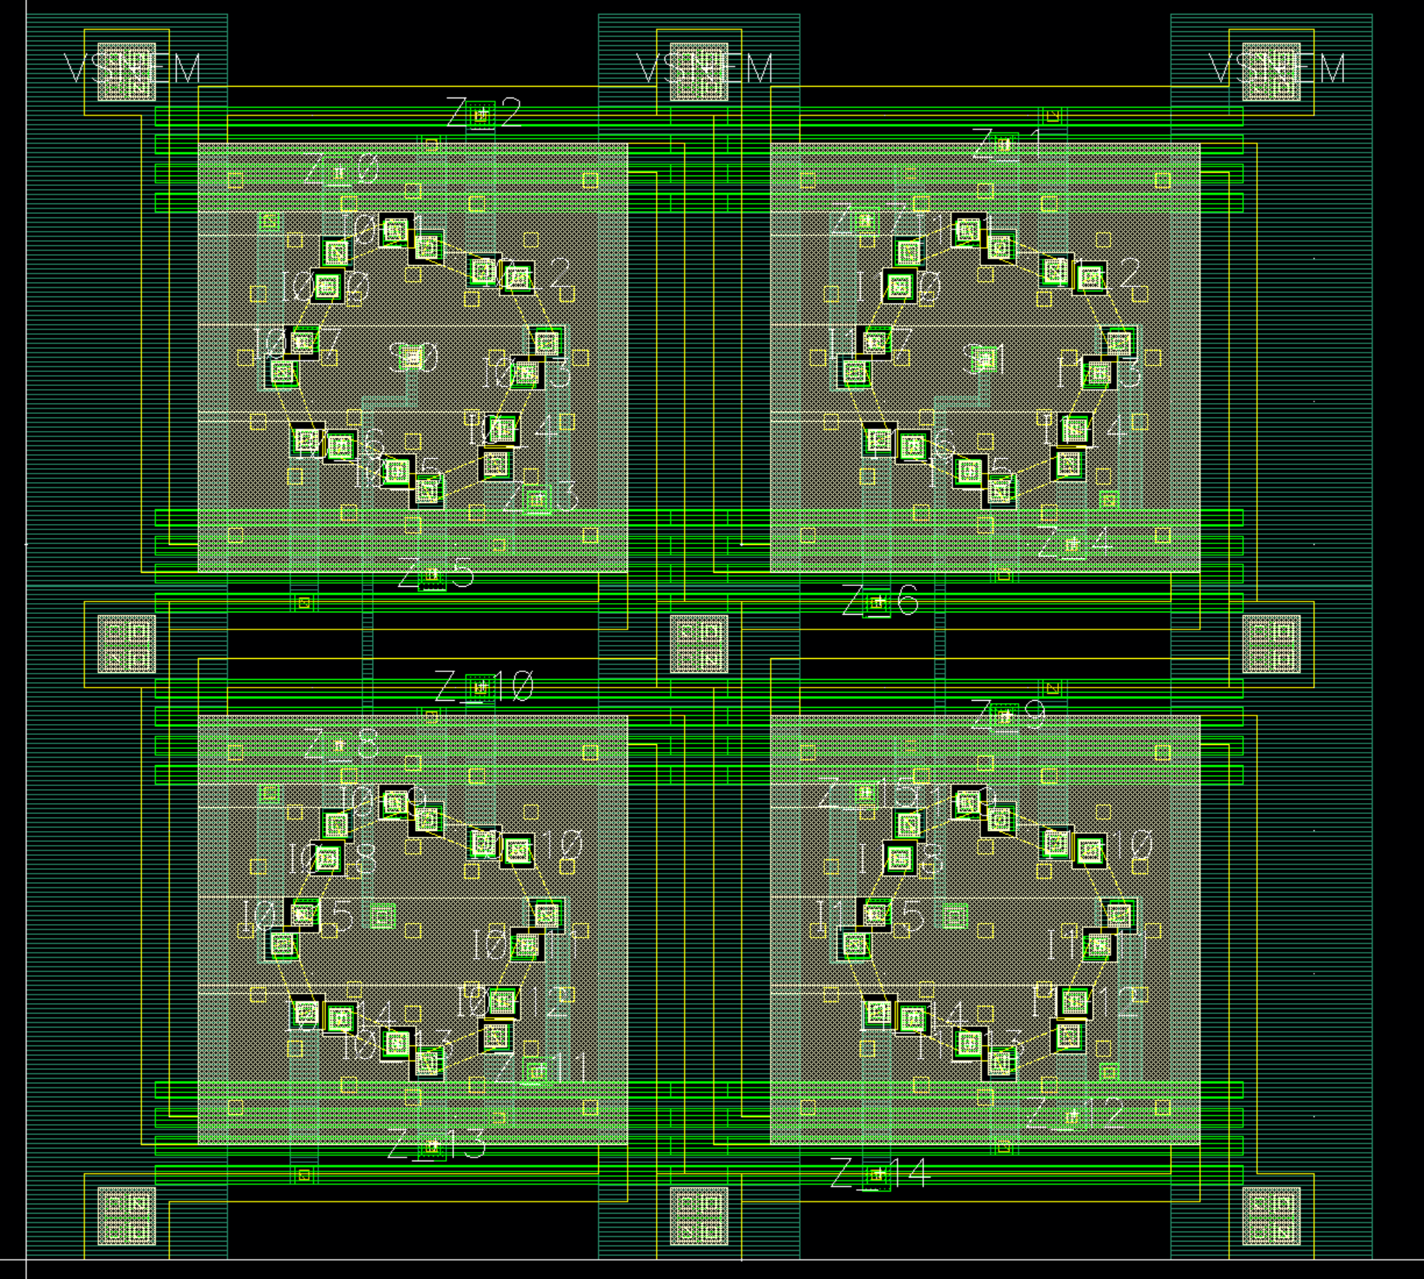
2-to-1 Mux, 16 bit
Design Challenges/Notes
All pins in M7 (except VSNEM in M8)
Neighboring relays share body connection
Very dense layout
Can’t run metal lines directly over S/D regions
Need to lead output pins away, then run horizontal z-lines across relay
Need to keep signal pins away from power rails
Don’t want via stack to run into M7/M6 VDD/VSS rails on the way down
NEM Relays need to “click into NEM relay sites” on chip (in between VSNEM rails)
Pitch of VSNEM rails chosen carefully
Pitch of VDD/VSS lines chosen carefully
NOTE: These layouts were done manually!
Notes:
Explain signals, power, etc. Why are pins led away? Why is power rail so fat?

Slide 19
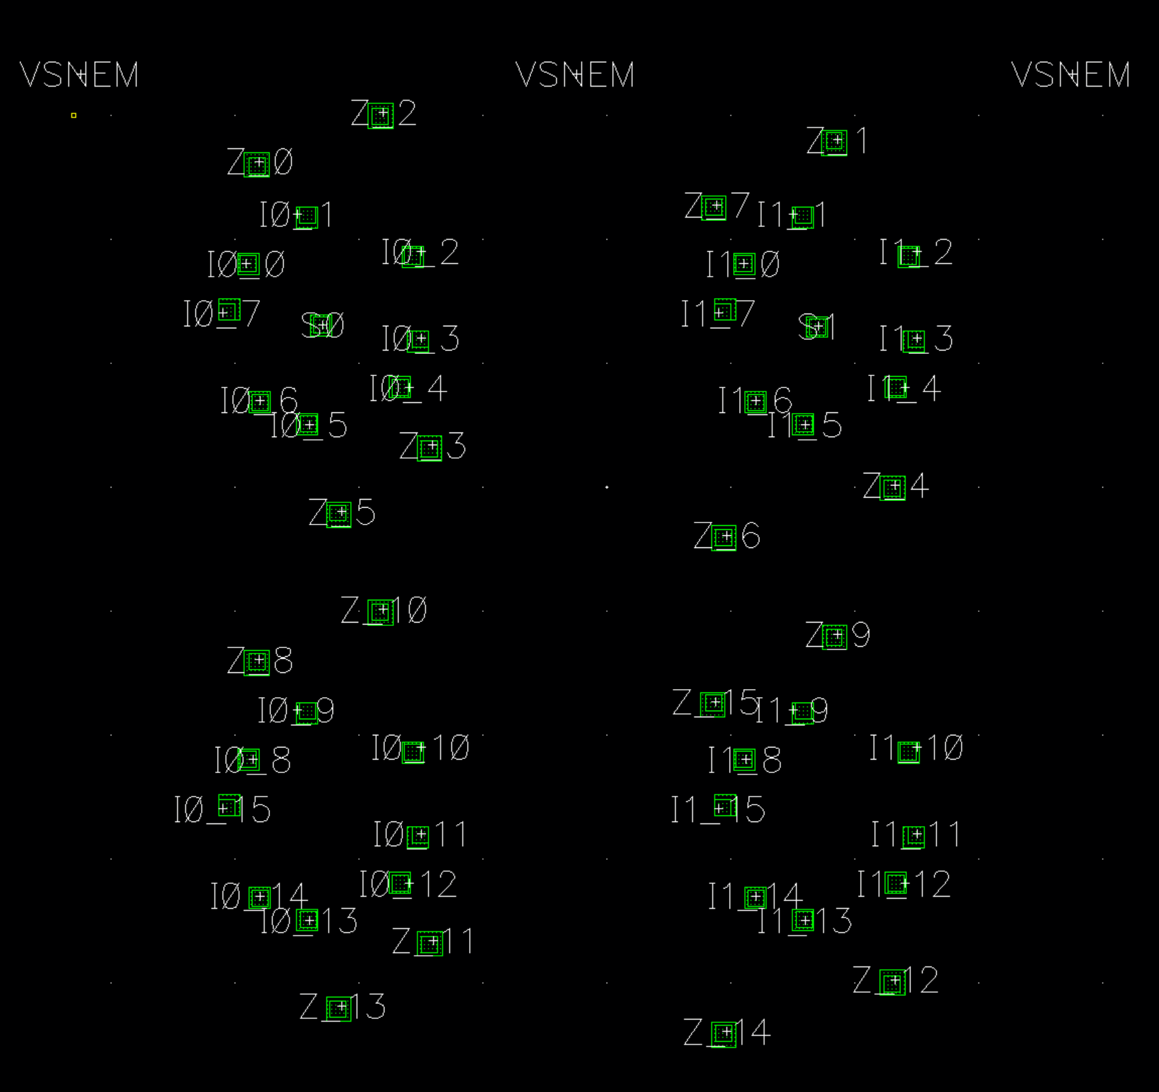
2-to-1 Mux, 16 bit (continued)

Slide 20
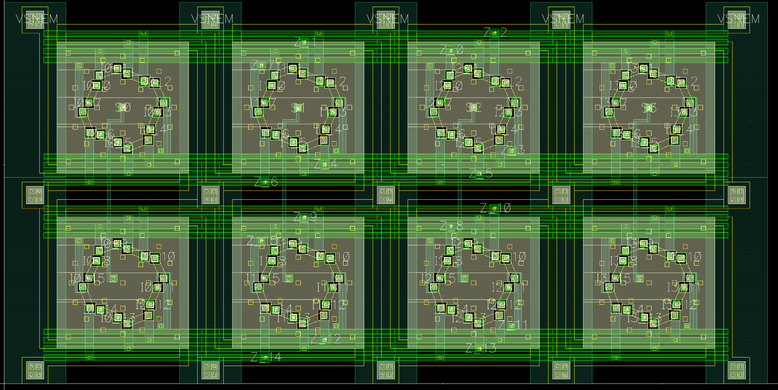
4-to-1 Mux, 16 bit

Slide 21
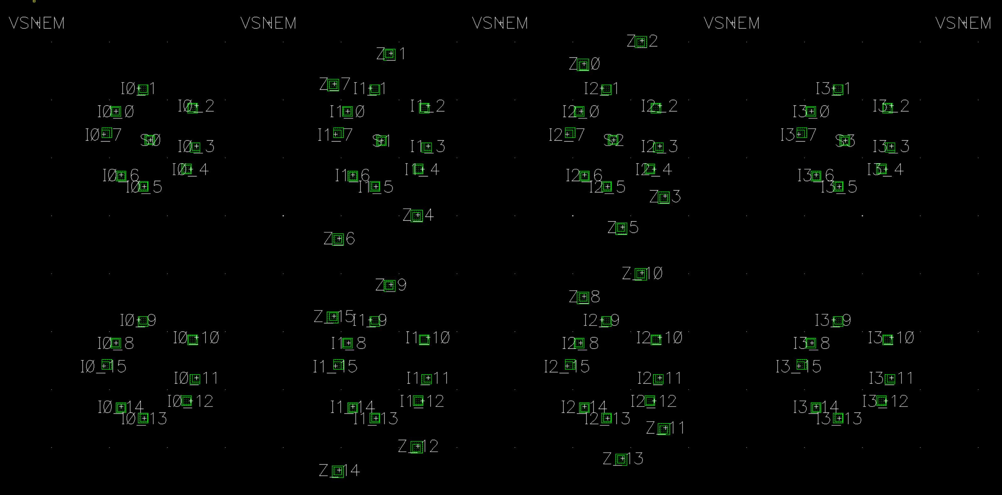
4-to-1Mux, 16bit (continued)

Slide 22
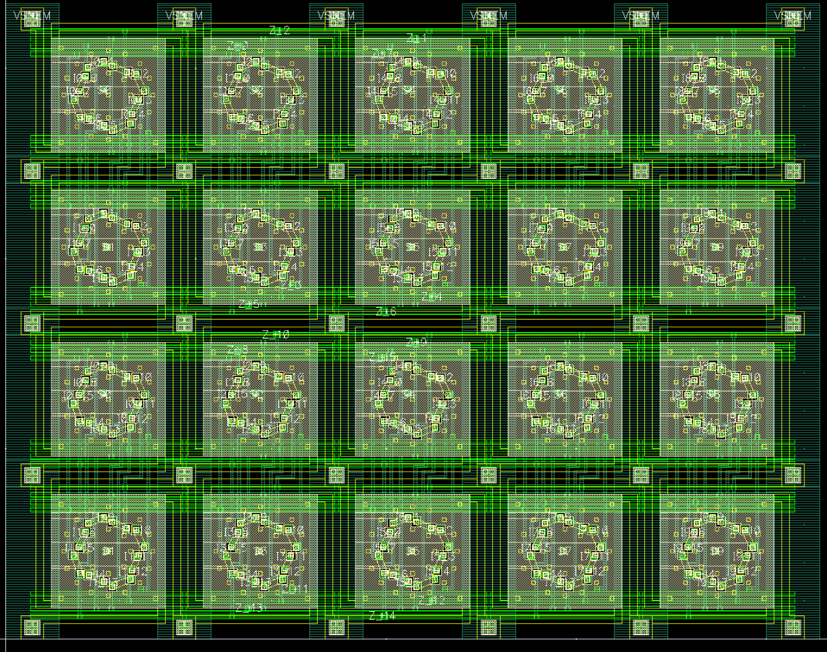
16-to-1 Mux, 16 bit
Design Challenges/Notes
16-to-1 mux, but don’t want long and skinny macro…
Stack 16-bit pairs on top of each other and route output nodes vertically, as well as horizontally
Jogs needed for vertical lines (to avoid obstacles)
Nearly all lines are min. width and min. spacing
Routing power (VSNEM) and signals in the same layer – could potentially cause coupling issues (will do analysis later)
Potentially large wire load capacitance seen at input and output pins
May increase delay
PnR tool may need to insert buffers (Area!)
Will analyze in PD flow
NOTE: These layouts were done manually!
Notes:
Explain how layout is organized I0 (0-7) I1 (0-7) I0 (8-15) I1 (8-15)

Slide 24
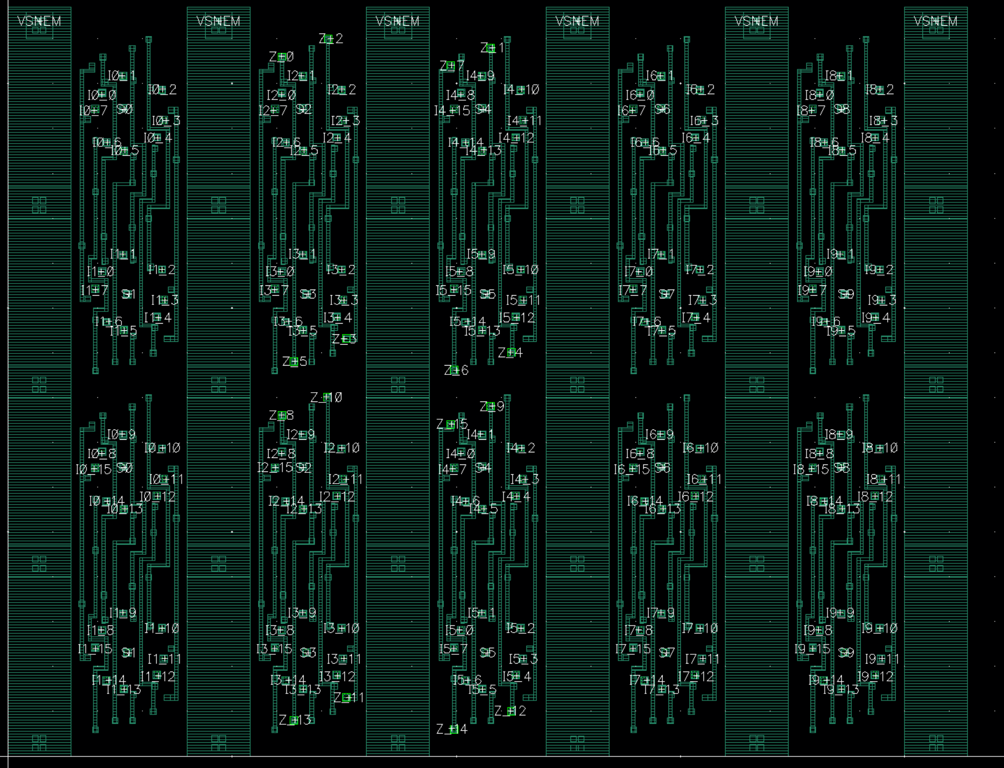
16-to-1 Mux, 16 bit (continued)

Slide 25
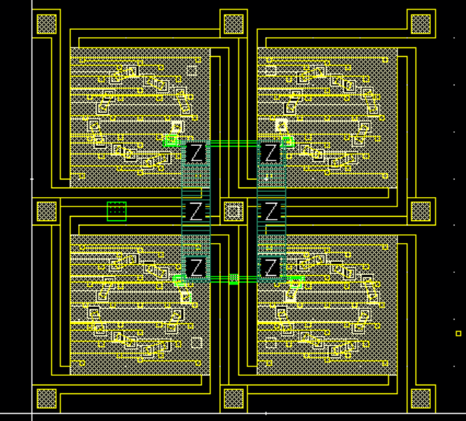
4-to-1, 1 bit example

Slide 26
Section 4
Preliminary area analysis

Slide 27
Area Analysis
NEM Layer
CMOS Layer
Required Chipcore area = max{CMOS Area, NEM Area}

Slide 28
Concept - Favorable 3D Place and Route
NEM Layer
CMOS-only implementation
CMOS Layer
Required Chipcore area = max{NEM Area, CMOS Area}
Total chipcore area is reduced

Slide 29
Concept - Unfavorable 3D Place and Route
NEM Layer
CMOS-only implementation
CMOS Layer
Required Chipcore area = max{NEM Area, CMOS Area}
Area increase If NEM Area > original chipcore area!
Notes:
Either this or the CMOS layer is too large due to buffers

Slide 30
NEM Relay vs. CMOS Size
NEM Relay pitch is 4um
Area = 4um x 4um
Much larger than CMOS std. cell area.
NEM relay cost must be amortized over a large # of stdcells.
CMOS std. cell
NEM Relay

Slide 31
Area Benefit (or penalty) Estimate
Relay pitch is 4um
0.3 um extension at each edge
Each NEM relay mux has “L” rows (of relays) and “W” cols (of relays)
Let “N” be total # of muxes in module
NEM-MUX_{area} = N * [(L * 4 um + 0.6um) * (W * 4um + 0.6um)]
Compare this to data on CMOS-only area for each SB, CB module

Slide 32
Area Benefit (or penalty) Estimate

Slide 33
CMOS-only implementation

Slide 34
NEM Layer
CMOS-layer

Slide 35
NEM Layer
CMOS-layer

Slide 36
NEM Layer
CMOS-layer
Optimum Point

Slide 37
NEM Layer
CMOS-layer
Unfavorable 3D place and route!

Slide 38
Relay vs. CMOS 3D PnR Tradeoff
Optimal operating point
Area
Area relay bound
Area CMOS bound
# of muxes mapped to relays
Total NEM layer area
Total CMOS layer area

Slide 39
Relay vs. CMOS 3D PnR Tradeoff – Implications
Not all muxes will be mapped to relays
E.g. In switch box where we have both 4:1 and 2:1 muxes
Consider mapping just the 2:1s
More analysis to come
Single-bit connection box (14:1) is out of the question (will stay in CMOS layer)

Slide 40
Section 5
3D Pnr flow: preliminary results + future plans

Slide 41
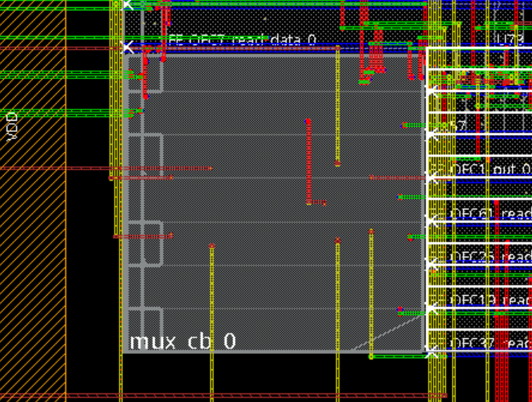
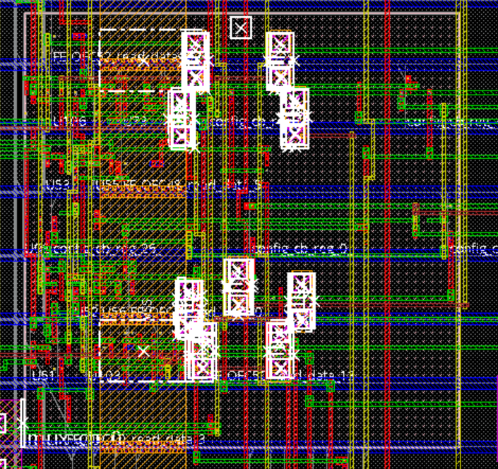
PD Update
July 2020
September 2020
Design Challenges/Notes
“Tricked” the PnR tool into doing a 3D place and route
PnR tool has a hard time with power routes
End up with shorts and open power nets if job left to PnR tool
Manual floorplan of macros required

Slide 42
End
Thanks for listening! Questions?

